Slide 1
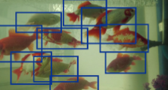
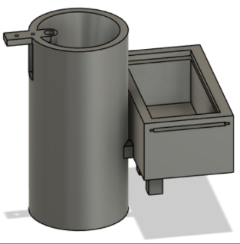
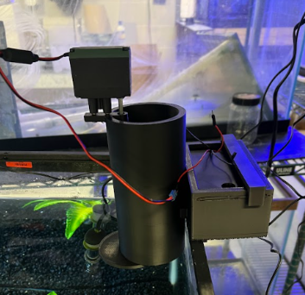
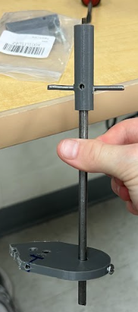
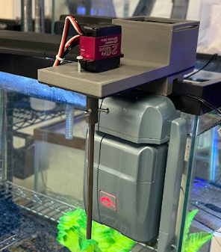
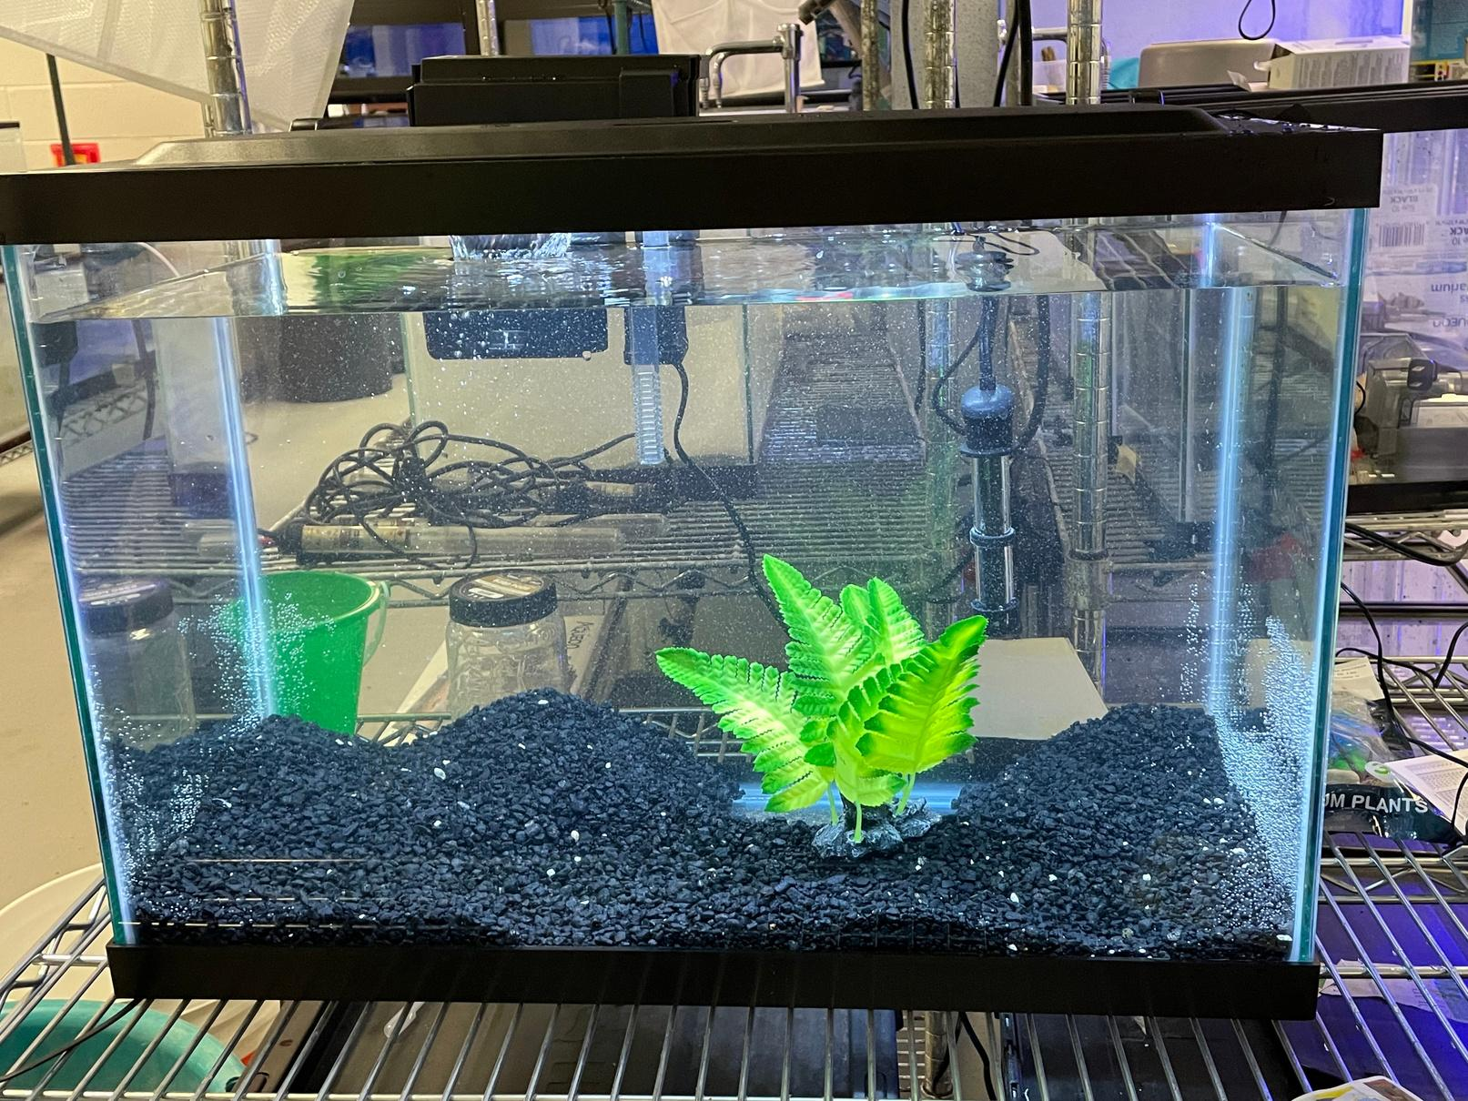
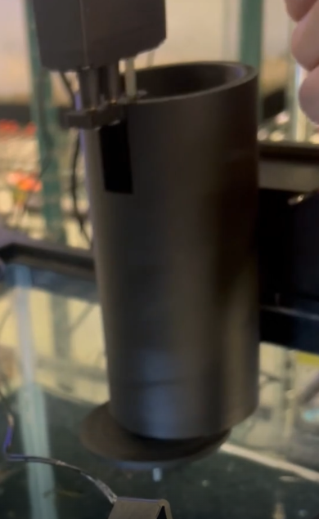
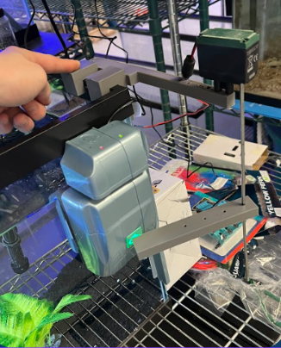
Smart Aquarium
Smart Aquarium System for Automated Environmental Monitoring and Fish Health Optimization
Computer Systems Lab
&
Engineering Lab
2025
Yilmaz, Behling, Parilla
Seraphim Amare
Jonathan French
Jason Park
Introduction
The process of maintaining water quality and fish health in aquatic systems has proved demanding and manual for numerous students at Marine Biology and Research. Monitoring aquarium water quality requirements and the feeding routine needs significant time commitment and results in potential human error. When managing a freshwater aquarium I designed a Smart Aquarium system which uses AI to automatically monitor environments as well as detect fish movements before taking real-time actions in response to changing conditions.
Figure 2: Food Dropper
Figure 1: Yolov8 model
Methods & Results
Figure 1 illustrates how the Smart Aquarium system implements YOLOv8 based convolutional neural networks (CNNs) to track fish movements and analyze ammonia sensor displays through color detection. Real-time processing of video data coming from UVC-compatible cameras occurs on a Raspberry Pi for fish activity detection combined with environmental change identification. The system uses detected information to trigger automated actions such as feeding shown in Figure 2 or send RoboSnail for cleaning as see in Figure 3. Thе Pi processеs all information locally to provide fast responsive system performance.
A CNN in our Smart Aquarium system tracks fish behavior to find changes in water quality. The system automatically initiates feeding after detecting limited movement from fish. The system triggers the robotic snail to perform tank cleaning operations when ammonia levels reach high levels. This enables the aquarium environment to maintain its health by reducing the need for human interaction as seen in the end results on Figure 4.
Novelty
Figure 3: RoboSnail & Actuator
The current system at TJ lacks the present mechanism to automate fish tank management. We have developed a system that tracks fish activity in real-time and water quality measurements while performing sensor-driven automated feeding and tank cleaning. Through the incorporation of a CNN model the system possesses the capability to make intelligence-based decisions for maintaining the tank environment. The solution stands out with its potential to merge machine learning capabilities with aquarium environmental control systems to deliver automated yet effective aquarium maintenance. The system design enables future modifications to suit different types of aquarium setups.
Impact & Future Work
Through automated managing of fish activity and water quality in the Smart Aquarium system a healthier aquatic environment exists that requires minimal human maintenance. Automated feeding and tank cleaning operations through the system decrease the requirement for human supervision. Follow-up research could concentrate on enhancing the CNN performance for better prediction precision while also increasing system flexibility and expanding its capability beyond water quality management to manage other aquarium conditions.
Figure 4.
Final
Components

